Slide 1
SURGICAL LIGHTS

Slide 2

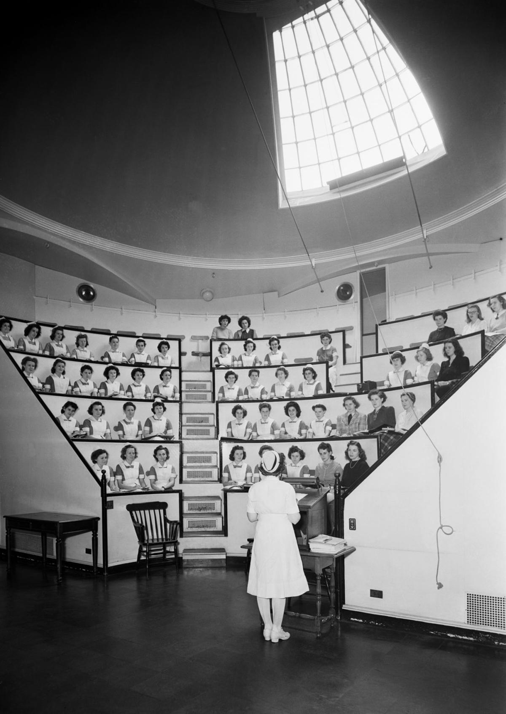
History
Before 1850’s
Ether Dome built in 1822.
Sunlight was used as surgical light.
South-East Facing windows.
Shade problems.
Mirrors were used.
Condensers to reduce heat.
10,000 lx to 80,000 lx brightness dependent upon daytime and cloud cover.

Slide 3
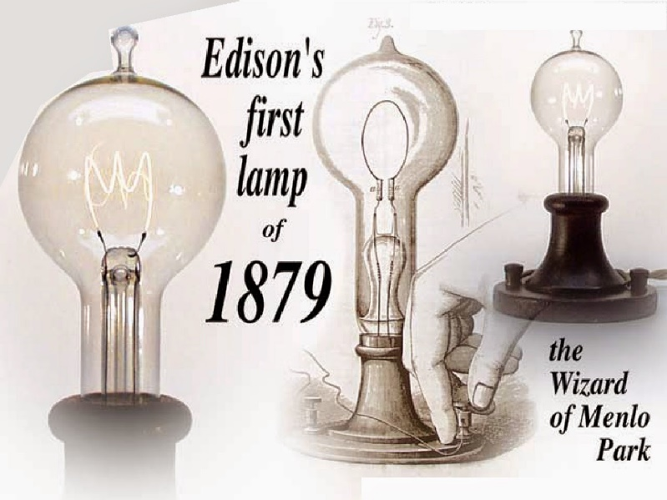
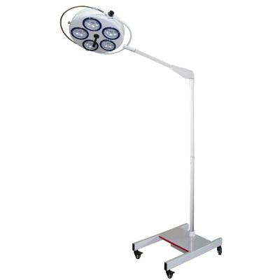
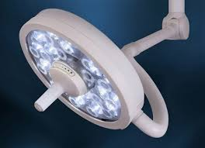
History
Year : 1850-1900
1879 – Edison’s electric bulb
Light produced when current is passed via carbonized bamboo filament.
Vacuum chamber helps in slowing melting process
Floor, Ceiling mounted lights.
Required by extensive surgeries.
Better angles: Better angles to operate ,more light, no time restriction.
Fast paced progress of hospitals.

Slide 4
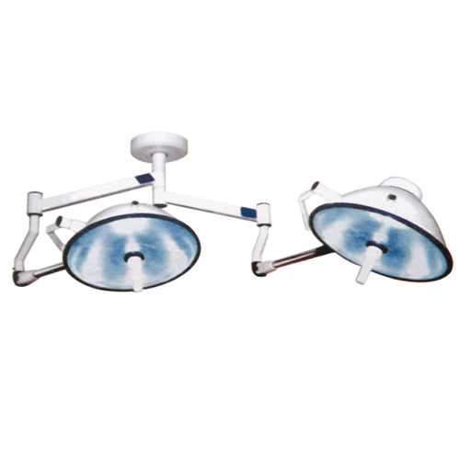
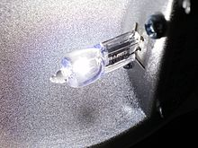
History
Year : 1960’s
Invention of fluorescent lamp
Made of tungsten filament sealed in a glass chamber of inert gasses.
Halogen/Inert gas used- iodine, bromine.
Halogen chemical cycle- increases lifetime, maintains clarity of bulb.
Higher efficiency and better colours.
Outer bigger glass.
Luminance = 1,00,000 lx

Slide 5
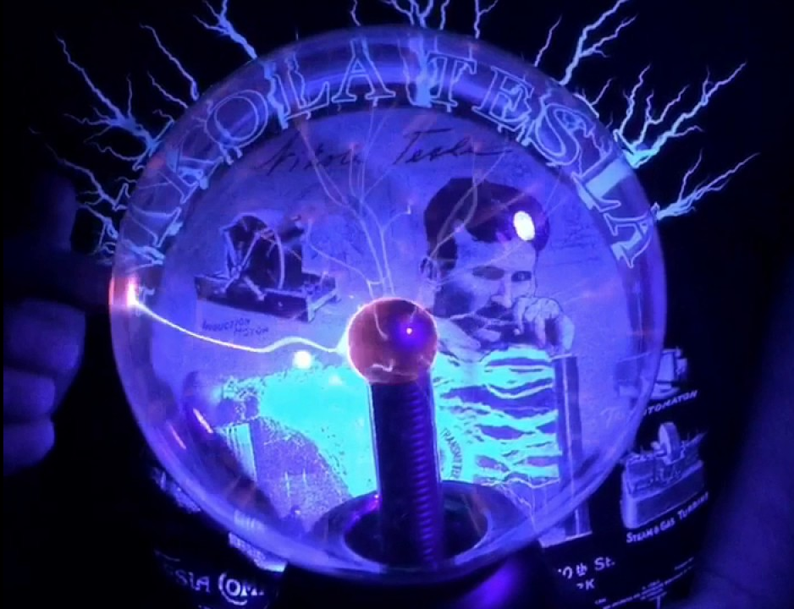
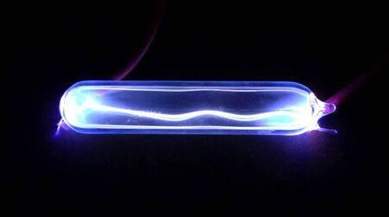
History
Year : 1990’s
Light by electric discharge through iodized gas.
Noble gasses- argon, xenon, neon, krypton.
May include- mercury , sodium, other metal halides. (Vaporizes at start-up)
Principle
Delay in Start-up.
Colour dependency – characteristic frequency of gas atoms.
Fluorescent lamps – coating converts UV to visible.
Huge efficiency compared to incandescent lamp and are complicated to manufacture.
Negative Resistance => requires ballasts preventing arc flashes
2x luminance i.e. 2,00,000 lx
Increased eye fatigue.
Decreased Surgeons efficiency.

Slide 6
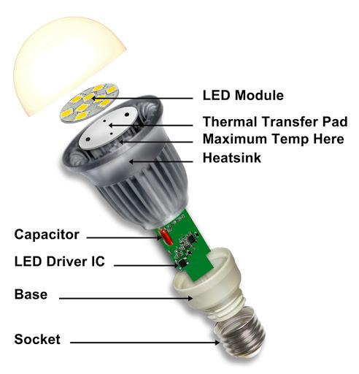
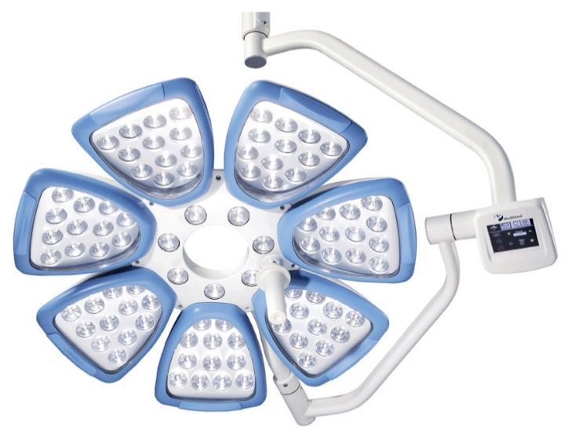
History
Year : 1990’s
Multiple times longer lifespan than incandescent , way more efficient than fluorescent lamp.
Requires driver circuit , loss produced.
303 to 200 lumens per watt.
Immediate start and frequent on/off doesn’t decrease life.
Brightness decreases with lifetime of LED.
Different colours can be achieved.
Run on DC and low voltages.
Circuit contains rectifiers, capacitors, and other components.
Simplified circuits due to series of junctions.
Nicer and cooler colours allow for better visibility during operation. Also removed radiations problems.
Can be ceiling , wall , ground mounted.

Slide 7
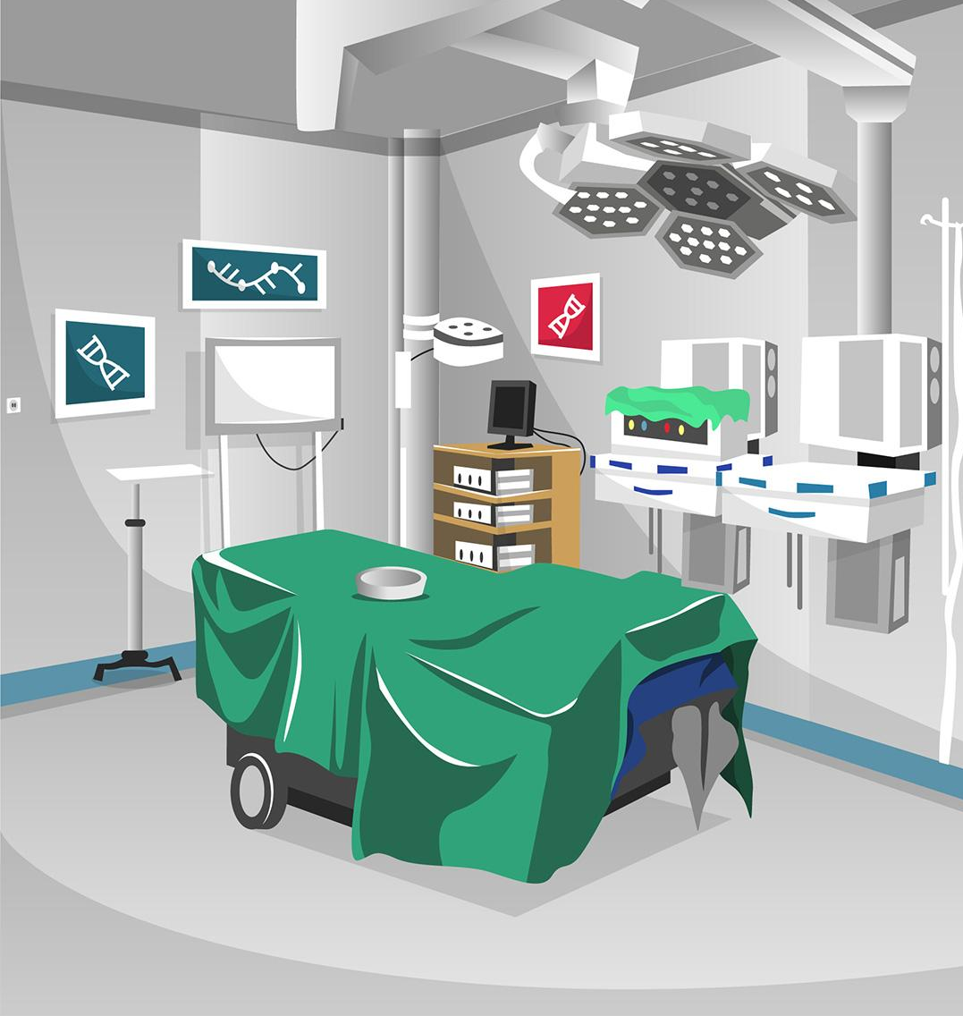
NEED FOR SURGICAL LIGHTS
"You cannot see what you are doing if you don’t have good light. You are doing delicate procedures and lighting is the most important part of surgery" – Surgeon at Duke University Medical Center.

Slide 8
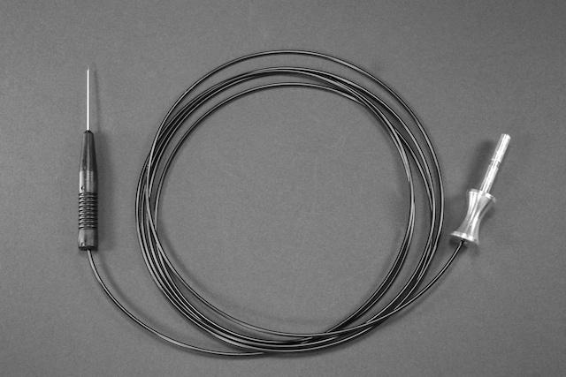
NEED FOR SURGICAL LIGHTS
User Controlled Lighting
Data collection includes voice recordings, radiology scans, patient data, images from endoscopic.
Using overhead, boom mounted cameras.
Lighting for these and display is critical.
Minimally Invasive Surgery- prob with controllable brightness needed as bright light also may not help.
Reduce Eyestrain. High brightness can fatigue surgeon’s eyes.

Slide 9
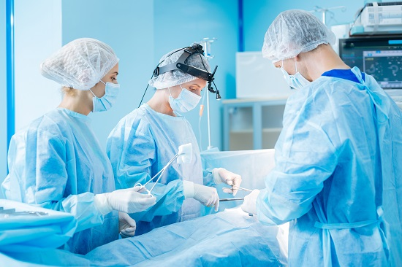
NEED FOR SURGICAL LIGHTS
Heat and Shadow Control
Minimization of shadows.
Different angled OT lights over the operation table helps in reducing shadows, with least amount of heat.
Impossible to completely remove shadows.
Reflector Technology – for minimizing shadow

Slide 10
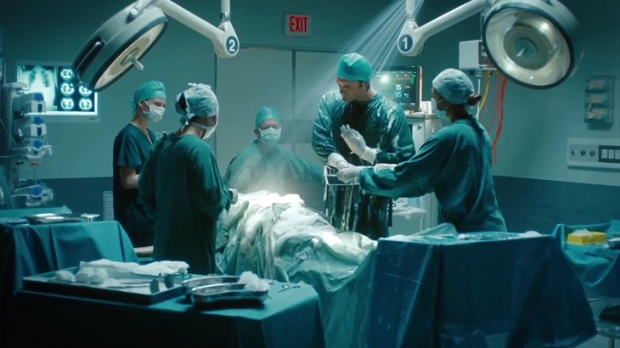
NEED FOR SURGICAL LIGHTS
Improved Visualization
Illuminate the surgical site for optimal visualization of small, low-contrast objects at varying depths in incisions and body cavities.

Slide 11
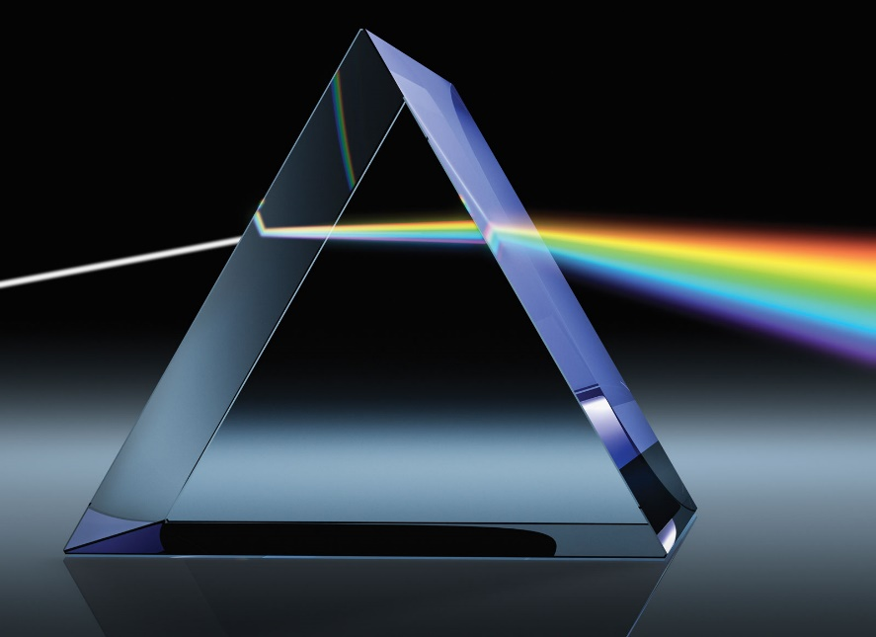
NEED FOR SURGICAL LIGHTS
Enhancement of Deep Colours
Hue should be such that it is easy to distinguish between different parts of the body ex: tissues, veins, wounds all should be of different identifiable colours.
CRI>95

Slide 12
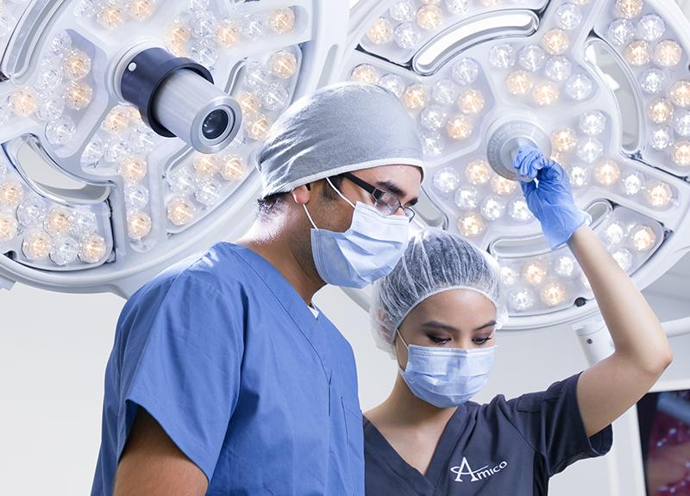
NEED FOR SURGICAL LIGHTS
Deep Cavity Illumination
Overhead lights wont help due to shadows.
Deep Incision – Requires light in order to operate.
Should illuminate deepest cuts.
Frustration increases with poor visibility
iCE LED surgical lighting system – shadow reduction and deep cavity illumination.

Slide 13
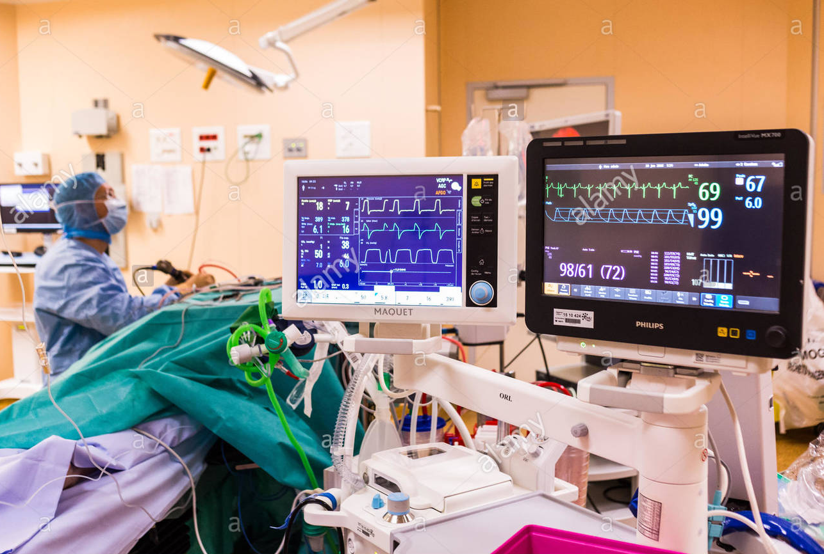
NEED FOR SURGICAL LIGHTS
Reduce Reflections, Glare and Poor Contrast
All types of ORs are incorporating various displays and monitors which can benefit from low levels of ambient illumination.

Slide 14
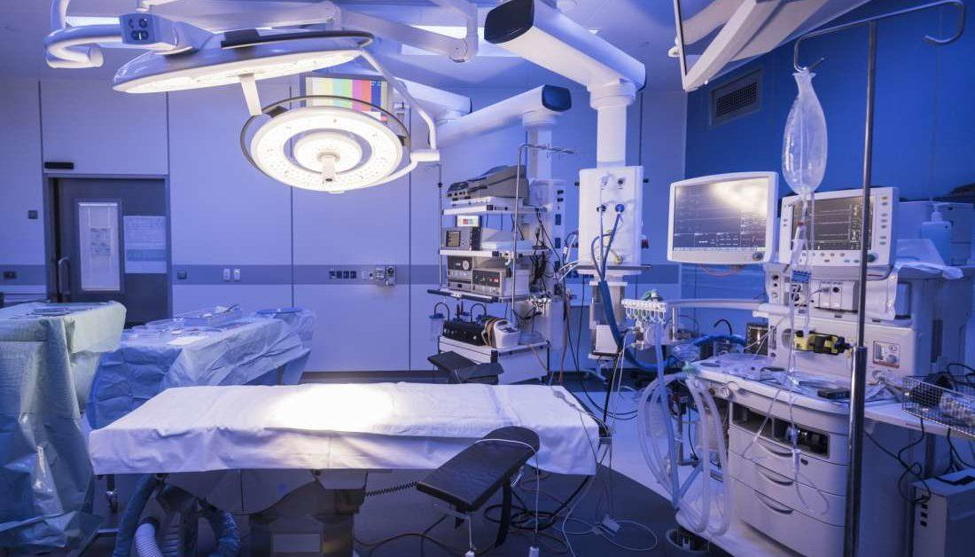
TECHNOLOGIES
IN
SURGICAL LIGHTING

Slide 15
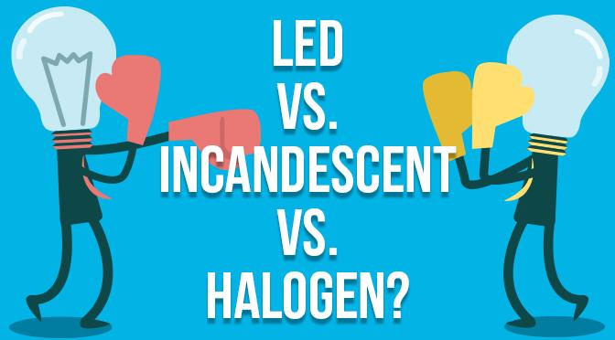
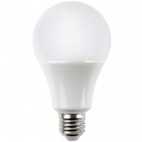
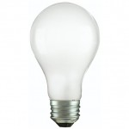
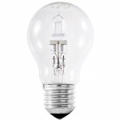
TYPES OF SURGICAL LIGHTS
LED
INCANDESCENT
HALOGEN

Slide 16
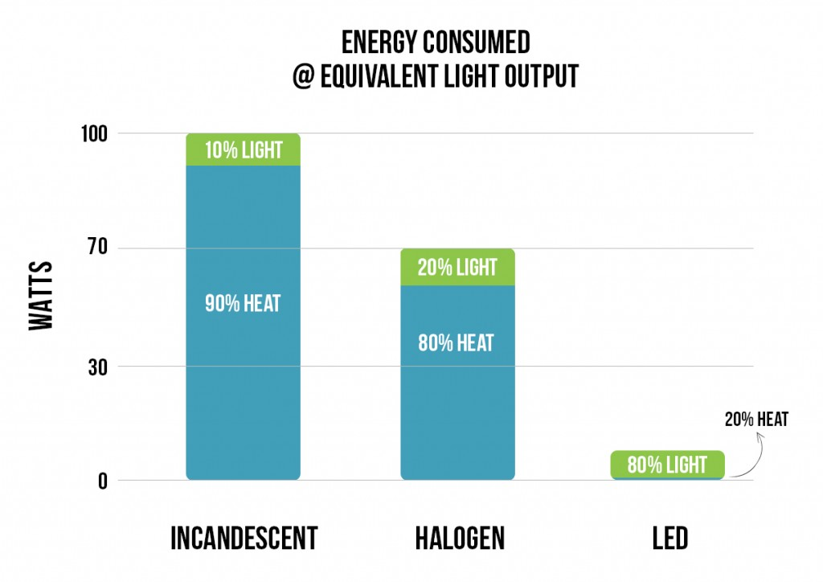
INCANDESCENT
Incandescent bulbs use—at most—10 percent of the energy they consume to make visible light; the other 90 percent is wasted heat.
They produce a considerable amount of infrared (IR) and ultraviolet (UV) radiation.

Slide 17
FEATURES
Incandescent bulbs use—at most—10 percent of the energy they consume to make visible light; the other 90 percent is wasted heat.
They produce a considerable amount of infrared (IR) and ultraviolet (UV) radiation that can be damaging to fabrics and artwork over time.
They’re designed to last around 1,200 hours.
Incandescent bulbs have a fragile glass envelope and brittle filament wire.
These bulbs are relatively cheap but consume so much energy that standard 40- and 60-watt options are no longer available for purchase in the U.S.
They create a warm yellow light.

Slide 18
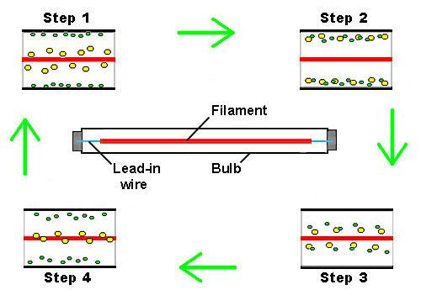
HALOGEN
They contain a tungsten filament, but unlike in incandescent bulbs, a small amount of halogen gas mixes with tungsten vapor and deposits it back onto the filament instead of on the inside of the bulb envelope.

Slide 19
FEATURES
Halogen bulbs come in many shapes but are commonly used as PAR, BR, AR, and MR spotlight or flood light bulbs
.
They produce a considerable amount of infrared (IR) and ultraviolet (UV) radiation that can be damaging to fabrics and artwork
.
These bulbs require an extremely hot running temperature to produce light and can cause burns if touched; the high temperature also prevents these bulbs from functioning as well in cold environments.
Halogen bulbs are extremely sensitive to skin oils, which can cause them to malfunction or burst
.
They last approximately 3,600 hours—three times longer than incandescent bulbs—but are not as efficient as compact fluorescent lamps (CFL) or LED bulbs.
Halogen bulbs have a fragile quartz envelope and brittle filament wire.
Because they operate at higher temperatures, halogen bulbs have higher color temperatures and produce brighter light than incandescent bulbs.

Slide 20
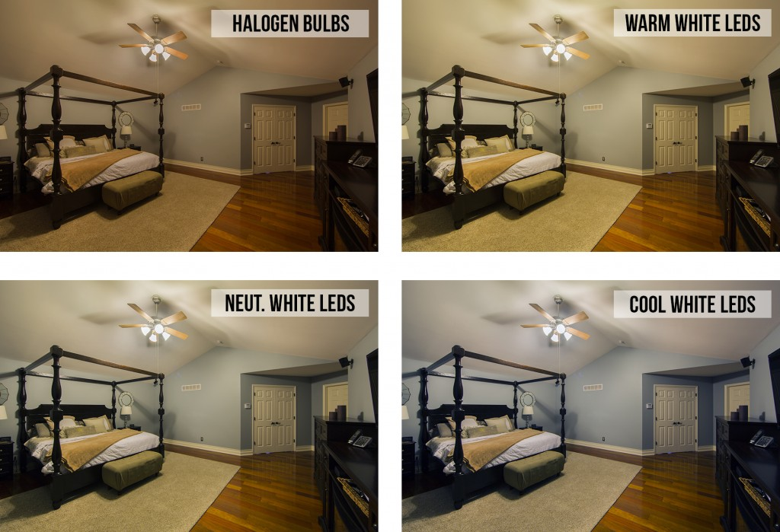
LED
LEDs produce the longest-lasting, most energy-efficient lighting available today.

Slide 21
FEATURES
LEDs run much cooler than incandescent and halogen bulbs, which greatly increases their longevity and enables them to function in cold temperatures.
Unless an LED is specifically infrared (IR) or ultraviolet (UV), it produces little to no IR or UV radiation, which can be damaging to fabrics and artwork.
They can last up to 50,000 hours—42 times longer than incandescent bulbs and 13 times longer than halogen bulbs.
Power consumption is the lowest compared to all other lighting technologies—80 percent less than incandescent bulbs and 75 percent less than halogen bulbs.
The shatterproof bulbs are shock resistant and have no brittle filaments.
LEDs require higher initial investment but produce greater energy returns over time.
LEDs contain no mercury, harmful gasses, or toxins.
They are available in many different whites and colors.
Because of their low power consumption, LEDs are great alternative lighting solutions for solar-powered systems.

Slide 22
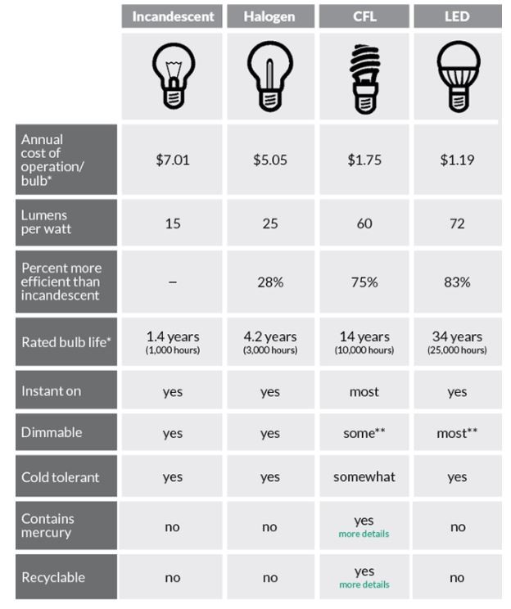
ADVANTAGES

Slide 23
LIGHTING METHODS
Quality lighting is critical for every operating room, and the method of light varies depending on staff needs. Three of the most prevalent methods are:
Overhead/operating lights
2. Headlamps/illuminated loupes
3. In-cavity lighting

Slide 24
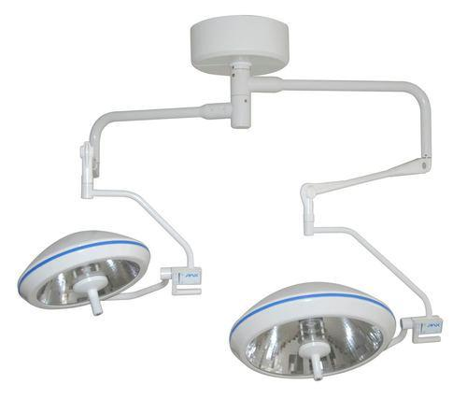
OVERHEAD LIGHTS
Overhead lights are usually either LED or incandescent. The lighting fixture can be mounted on a ceiling or wall and have handles that allow the surgeon to adjust the lighting as they see fit. It is also adjustable to help prevent glare.

Slide 25
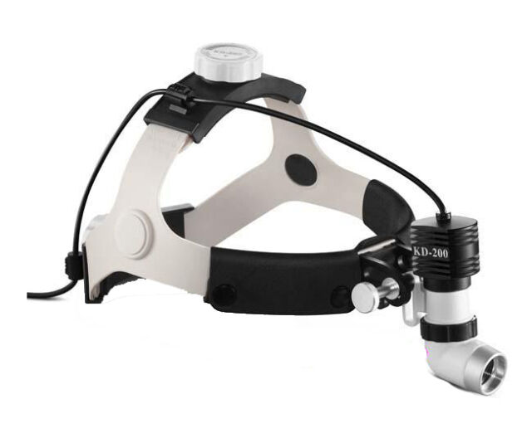
HEAD LAMPS
Headlamps can offer brightness, dependability and comfort for surgeons. The lights are wearable and allow light to follow the attention of the surgeon. Headlamps help create mobility for the surgeon and shadow -free illumination.

Slide 26
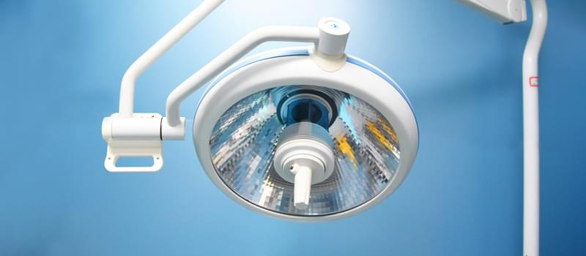
IN CAVITY LIGHTING
In-cavity lighting allows for lighting deep inside surgical cavities. If current overhead and headlamp lighting are not adequate, in-cavity lighting is a viable option.
With this type of light, the light source is typically outside of the sterile field, meaning it can be a fixed light on its own or connected to a surgical retractor or instrument.

Slide 27
TERMINOLOGY
LUX
CENTRAL ILLUMINANCE
LIGHT FIELD CENTRE
DEPTH OF ILLUMINATION
SHADOW DILUTION
D10 AND D50

Slide 28
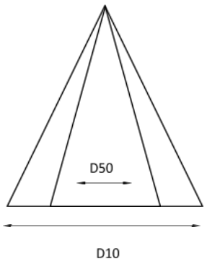
FIELD DIAMETER
The smaller arrow is D50 while the larger arrow is D10. This simply means that 50 percent of the entire pie of light intensity should fall within 50 % of its total diameter.

Slide 29
CERTAIN NORMS
HOMOGENOUS LIGHT
LUX
LIGHT FIELD DIAMETER
COLOUR RENDITION
BACKUP POSSIBILITY
ANNOUNCEMENTS

Slide 30
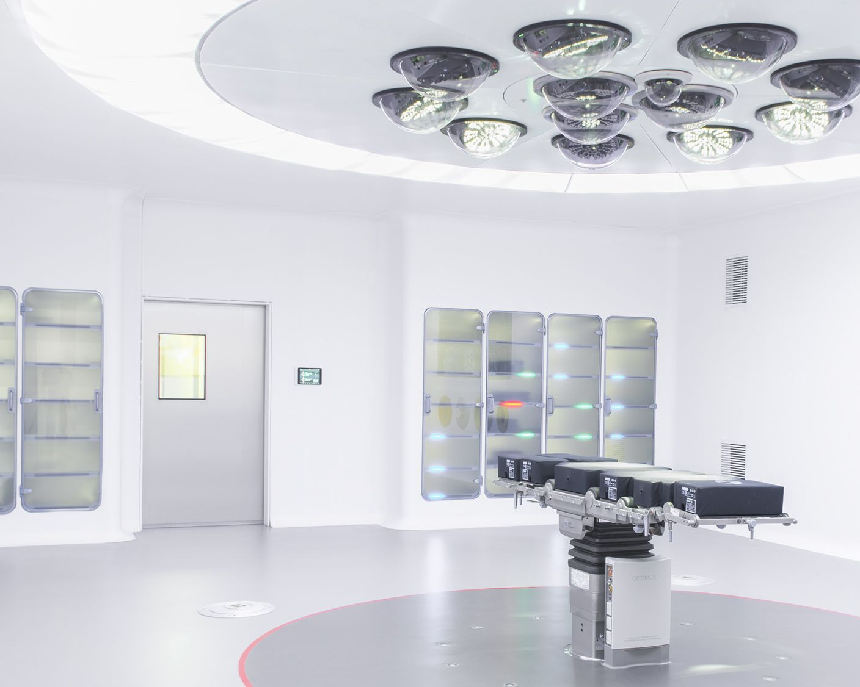
OPERATION THEATRE LIGHTS

Slide 31
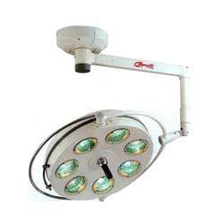
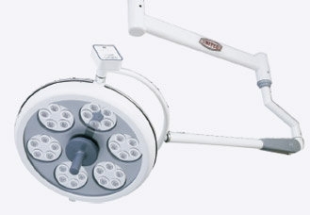
Why LED and not Halogen OT Lights?
Halogen OT Light
LED OT LIGHT

Slide 32
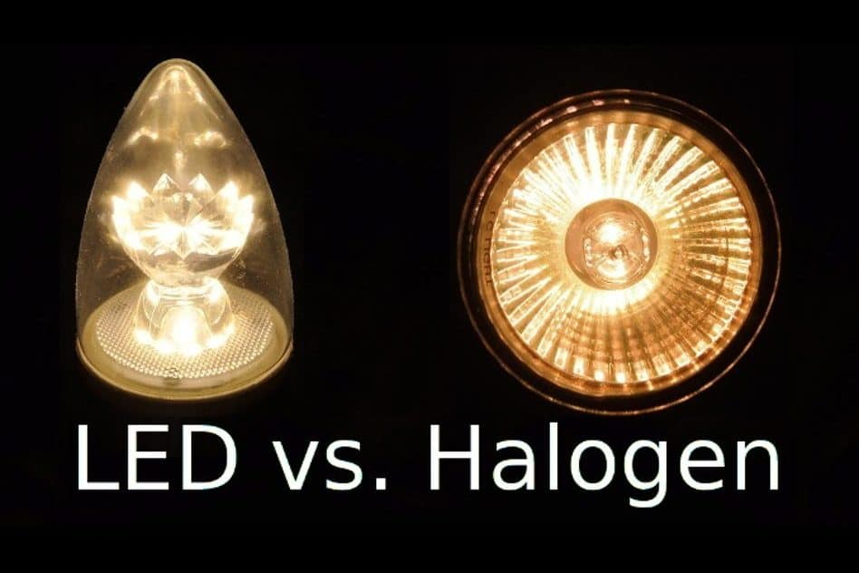
In October 2010, acknowledging rapid improvements in light-emitting diode (LED) technology, the HEA Lighting Project Team selected LED surgical task lighting as a project to explore in 2011. A scoping study was completed in January 2011, characterizing the energy-savings potential of currently available LED products relative to tungsten-halogen (halogen) and high-intensity discharge (HID) benchmarks.

Slide 33
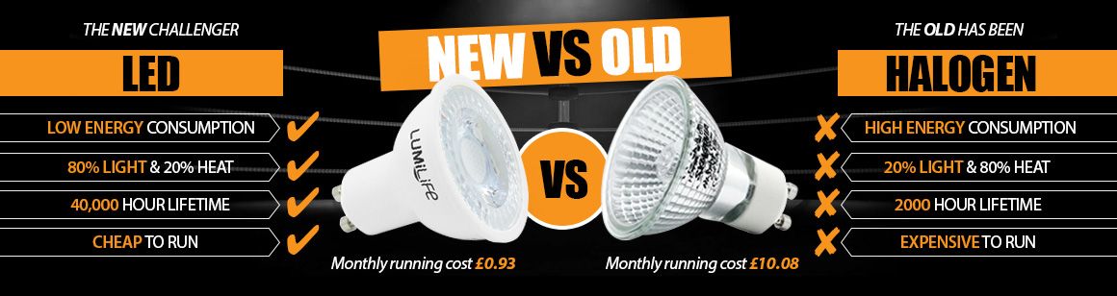
LED VS HALOGEN

Slide 34
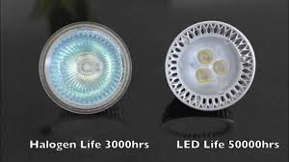
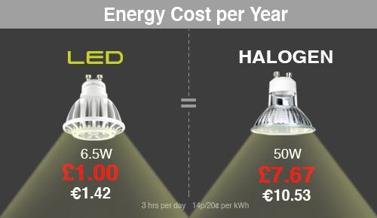
The features which leads many medical facilities to opt for LEDs in various situations are:
Color Variation
Heat
Efficiency
Reliability
Energy Usage
Cost

Slide 35
Various Parameters Of OT Lights
LUX:
The unit of measurement for the amount of light at a given point and is measured using a lux meter at that point.
Central Illuminance (Ec):
The Illuminance (lx) at 1m distance from the light emitting surface in the light-field center and is measured in lumens per square meter.
Light Field Centre
Light Field Diameter(D10):
Diameter of the light field around light field center, ending where the illuminance reaches 10% of central illuminance.
D50:
Diameter of the light field around light field center, ending where the illuminance reaches 50% of central illuminance.

Slide 36
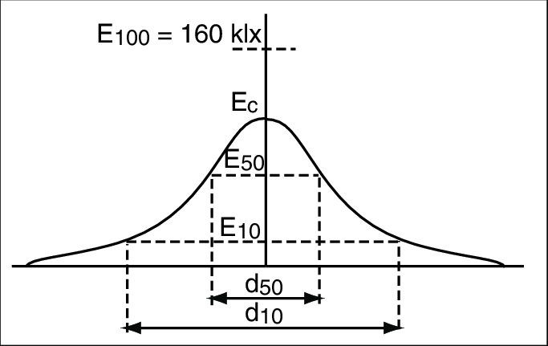

Slide 37
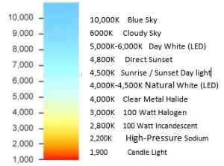
Correlated Color Temperature(CCT):
The perceived coolness or warmth of light measured in Kelvin. Color temperature is essentially a gauge of how yellow or blue the color of light emitted from a light bulb appears.

Slide 38
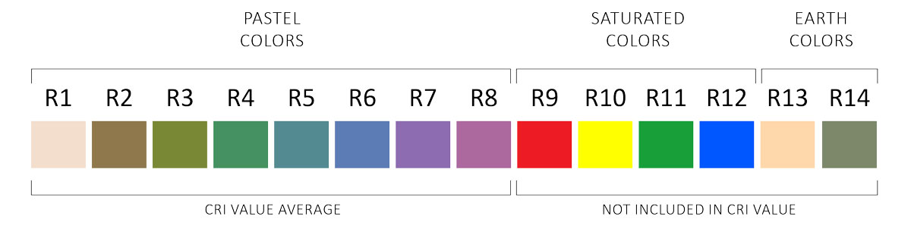
Color Rendition Index (Ra & R9): The effect the light source has on the appearance of colored objects (tissue for example). This is a measure of the quality of light; natural daylight has a CRI value of 100. The closer an operating theatre light CRI value is to 100, the better its ability to render true colors to the human eye. It is important to appreciate how well the light renders a saturated deep red color (R9) which will allow the surgeon to recognize details better in the area of the wound and to distinguish between tissue colors and arterial or venous blood.

Slide 39
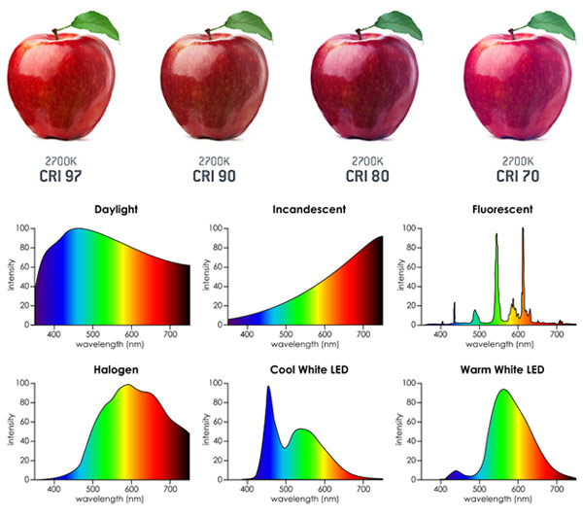
How Different CRI value changes the Perception of the object

Slide 40
Shadow Dilution:
Refers to the light’s ability to minimize the effect of obstructions. An absence of cast shadow or colored shadow is described as perfect shadow dilution.
Depth of Illumination:
The distance under the light emitting area where the illumination reaches 20% of the central illuminance.
Fail Safe:
The backup possibility in case of interruption of the main power
supply.

Slide 41
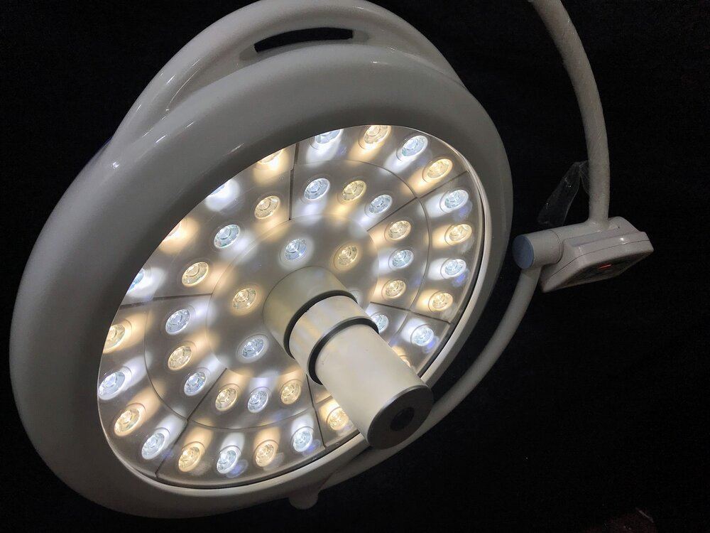
Imaging In OT Lights

Slide 42
Many times as per requirements OT Lights may have camera pre installed , and some of the specification criteria required for selecting the camera are explained as follows:
Optical Zoom
Digital Zoom
White Balance
Exposure
Shutter Speed
BLC(Backlight Compensation)

Slide 43
Optical And Digital Zoom
Optical Zoom:
Optical zoom is achieved by using a series of lens elements. Glass can move through the lens to zoom in or out. Optical zoom offers the best results and is the truest form of image magnification. Optical zoom offers lossless results. Optical zoom offers the best results and is the truest form of image magnification.
Digital Zoom:
Digital zoom is similar to optical zoom, without mechanical work or glass elements. It will essentially cut off areas around your scene to make it seem like you are closer to the subject. The remaining part of the image is enlarged using algorithms, hence the name digital. Unlike optical zoom, digital zoom is not lossless.

Slide 44
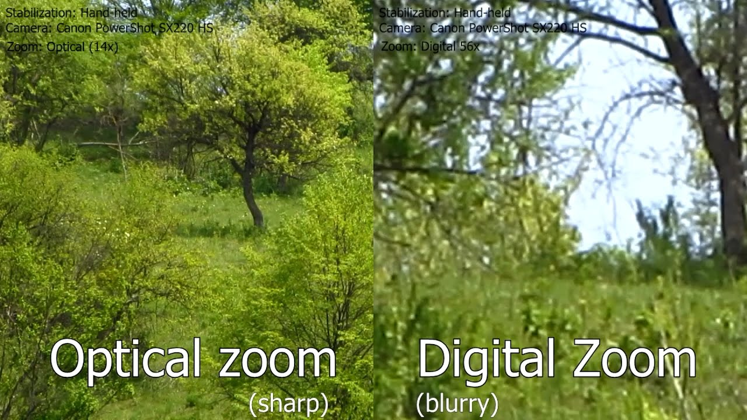
Optical And Digital Zoom

Slide 45
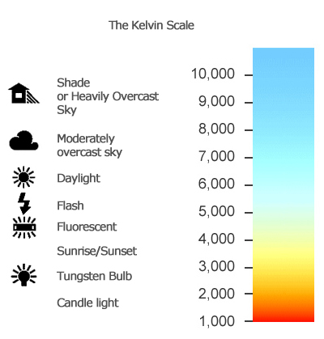
White Balance
White balance (WB) is the process of removing unrealistic color casts, so that objects which appear white in person are rendered white in your photo. Proper camera white balance has to take into account the "color temperature" of a light source.

Slide 46
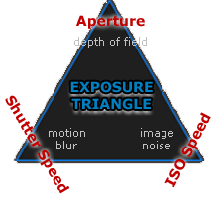
Shutter Speed and Exposure
Shutter Speed:
Shutter speed is the length of time when the digital sensor inside the camera is exposed to light, also when a camera's shutter is open when taking a photograph.
Exposure:
Exposure is the amount of light per unit area reaching a electronic
image sensor, as determined by shutter speed, lens aperture, and scene
luminance.

Slide 47
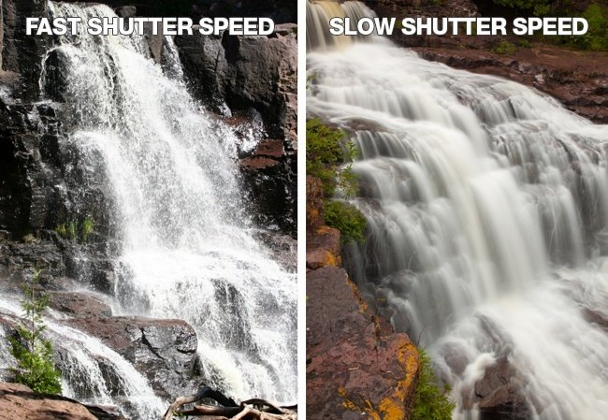
Fast And Slow Shutter Speed

Slide 48
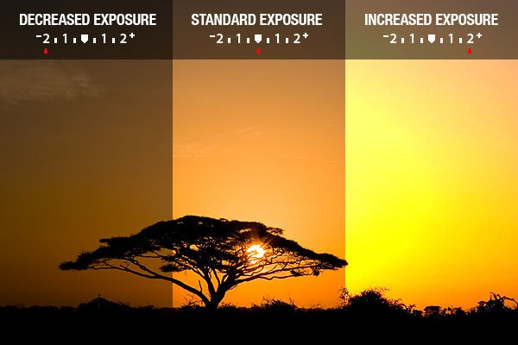
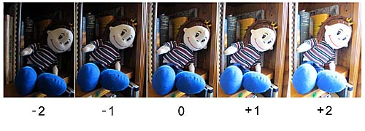
Exposure Compensation

Slide 49
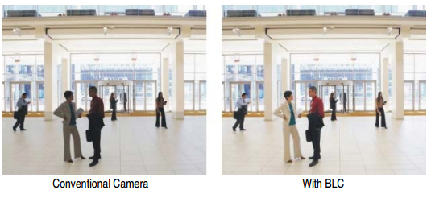
Backlight Compensation
Backlight Compensation is a term which describes the mechanism by which an camera can compensate for backlight by enhancing automatic exposure control on the camera.
BLC allows the camera to adjust the exposure of the entire image to properly expose the subject in the foreground.

